Slide 1
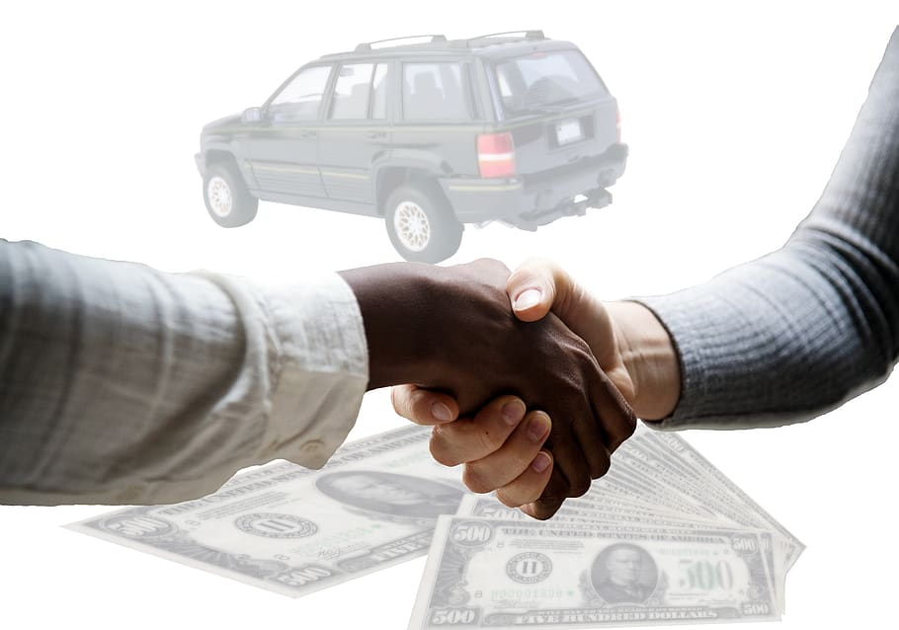
Car Sales Trading Management System

Slide 2
PURPOSE
car sale system which lets a customer to find a car and its details is the main objective of this project. Both the user and the administrators can access enter the details of every car. Administrators are responsible of maintaining the details of vehicles like the Manufacturer information, Year, Model, Price, and Kilometers traveled etc.

Slide 3
Features
It track all the information of Customer, Cars, Sale etc.
Manage the information of Customer.
Shows the information and description of the inventory, Cars Models.
To increase efficiency of managing the inventory, Customer
.
Integration of all the records of Car Owners.

Slide 4
Modules
Admin module
Login System
Maintenance Module
Vehicle Details
Vehicle Showroom management System
Finance Module
Logout

Slide 5
Admin Module
Admin is the Super user of the system.
He is responsible for the creation and maintenance of the accounts to the system.
Admin is responsible for the creation of different kind of managers.
Admin looks after the maintenance of these accounts.
He has a feature of getting the password of a username .

Slide 6
Login System
A login system is a security feature that prevents
unauthorized users from accessing resources on a
website.
It denotes that the user has been identified and
authenticated in order to gain access to the most
Common website. The best combination is a
username and password.

Slide 7
Maintenance Module
Maintenance manager is one of the user in the system.
The main functionalities of this manager is to add vehicles, drivers and vendors of the vehicles.
The Maintenance manager is responsible
for the Spare parts billing, registering the vehicles , drivers to the vehicles, mostly the vendor details and date of purchase of vehicles.
These details provide Manager whether the cabs are providing profit or loss.

Slide 8
Vehicle Details
The data that we are going to use in this module is about cars. Specifically containing various information data points about the used cars, like their price, color, etc. Here we need to understand that simply collecting data isn’t enough. Raw data isn’t useful. Here data analysis plays a vital role in unlocking the information that we require and to gain new insights into this raw data.

Slide 9
Finance Module
He is responsible for the cost estimation of the vendor, vehicle billing and viewing the feedbacks posted by the employees on the events as accidents and the driving nature of a particular cab.
The Feedback posted by employers give the quality and performance of the cabs, by this result managers get a chance to improve the performance of the transportation to get profits.

Slide 10
Vehicle Showroom Management system
He is responsible for the Maintaining the Quality in the transportation, to provide Quality.
He checks the performance by maintaining the feedbacks from employees and the accident details of the Cab.
Here Quality Assurance Manager is responsible for inserting and maintaining the Accident details, by this details here quests for the finance manager to provide the Amount to the damage

Slide 11
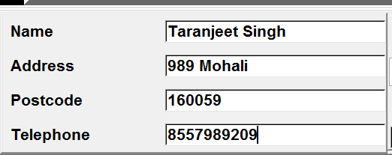
Login system

Slide 12
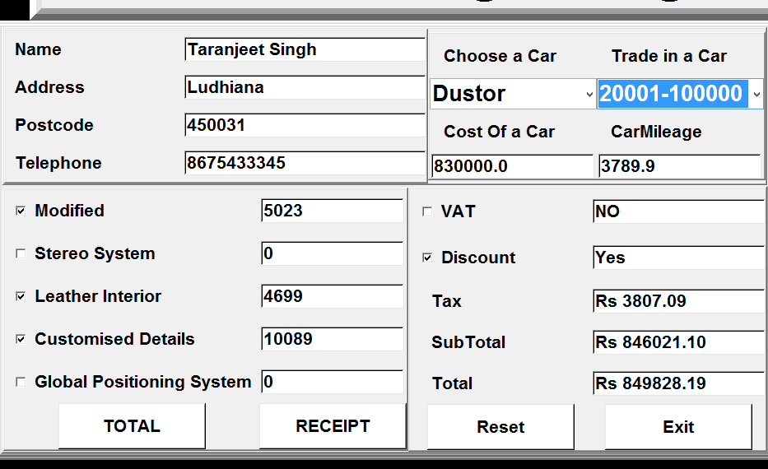
User Details and car Details

Slide 13
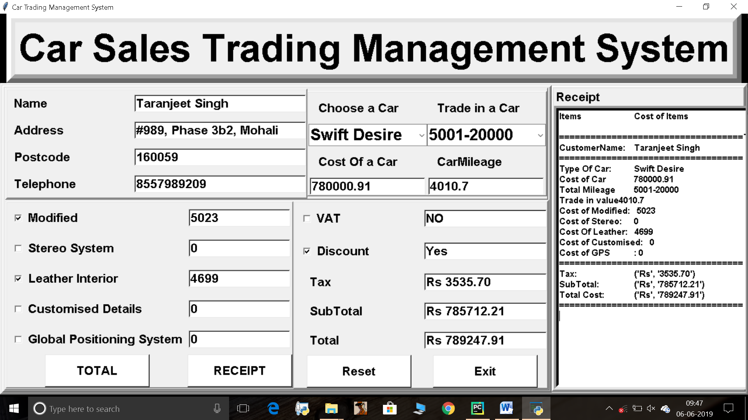
Car sales Trading management system

Slide 14


